Slide 1
AWS Capstone Project
Amir Ali, Stanisław Mateuszewski, Mateusz Kierznowski

Slide 2
Outline
Project Overview
Application Architecture
Amazon VPC
RDS database
Backup Configuration
Load Balancer
Auto Scaling
Application Architecture(final)

Slide 3
Project Overview
Deploy a PHP application that runs on an Amazon Elastic Compute Cloud (Amazon EC2) instance.
Create a database instance that the PHP application can query.
Create a MySQL database from a structured query language (SQL) dump file.
Update application parameters in an AWS Systems Manager Parameter Store.
Secure the application to prevent public access to backend systems.

Slide 4
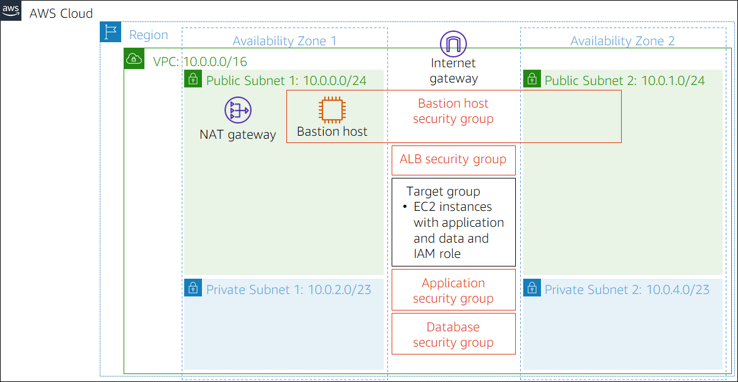
Application Architecture (Given)

Slide 5
Required Solution
Provide secure hosting of the MySQL database
Provide secure access for an administrative user
Provide anonymous access to web users
Run the website on a t2.micro EC2 instance, and provide Secure Shell (SSH) access to administrators
Provide high availability to the website through a load balancer
Store database connection information in the AWS Systems Manager Parameter Store
Provide automatic scaling that uses a launch template

Slide 6
Amazon (VPC)
Subnet
Private Subnet 1
Private Subnet 2
Public Sunet 1
Public Subnet 2
Security Group
Inventory app
ALB
Bastion
DB

Slide 7
RDS database
Muliti-AZ DB
T3.micro (vCPU:2, 1 GB memory)
no public access

Slide 8
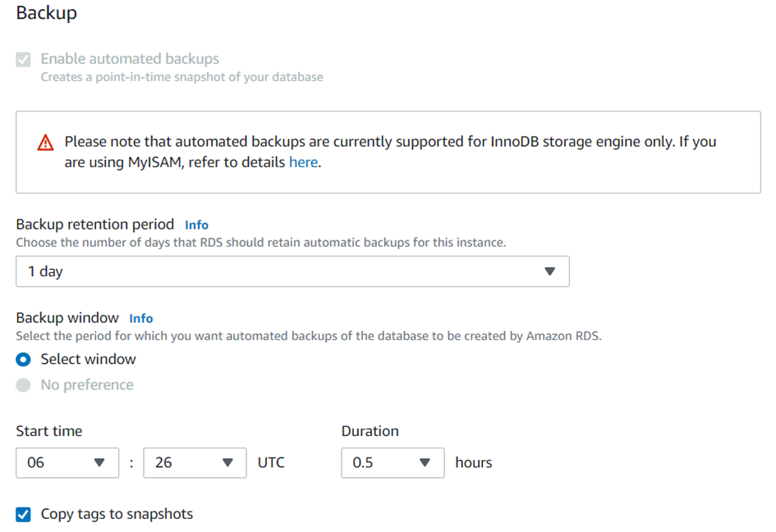
Backup configuration

Slide 9
Load Balancer
Load balancers are servers with forward internet traffic into different EC2 instances
Redirect traffic to working instances
We have chosen Application Load Balancer
Target Group: our 2+ web services

Slide 10
Auto Scaling
Add or remove instances while increasing/decreasing load
Add or remove instances of Web Server while load changes over time.
Works as auto scaling group for Public subnet 1 and 2
Minimum/Desired capacity is 2, maximum capacity it’s 4

Slide 11
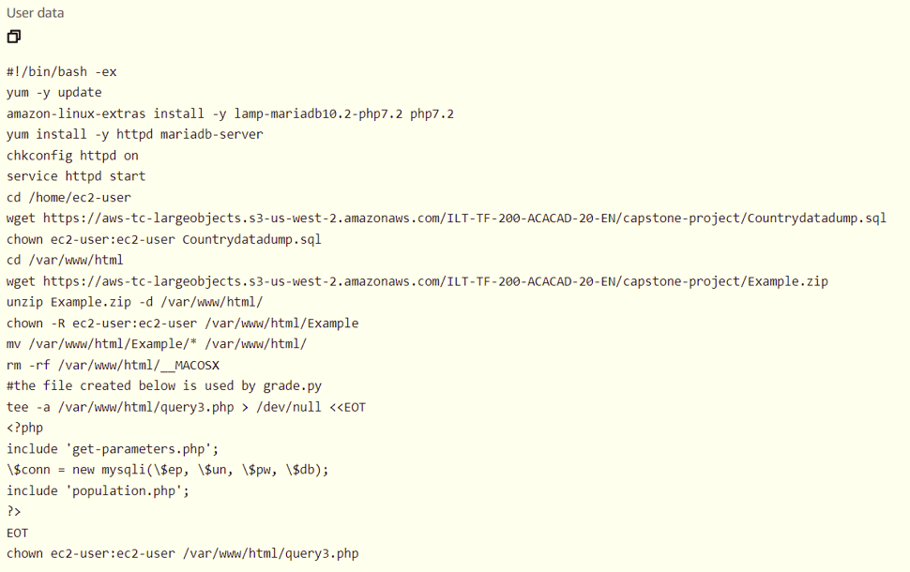
Web Services from LT

Slide 12
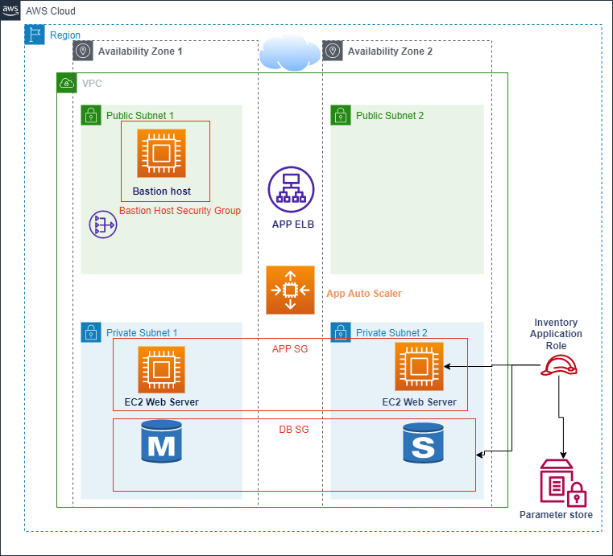
Application Architecture

